Slide 1
ARstone
João Trindade, Nº 80805
Joana Hrotkó, Nº 81423
Pedro Monteiro, Nº 90850

Slide 2
What we want to do
Card game like Hearthstone (physical cards)
Simple game, only a few cards
For mobile AR
Developed in Unity for the HMD
GoogleVR SDK
Vuforia SDK

Slide 3
What we want you to experience
Bring the cards to life: 3D models, animations, sound
Single-player (multiplayer possible with 2 HMD’s)
Improve presence in physical card games
By giving life to the cards
By displaying your resources on the user interface

Slide 4
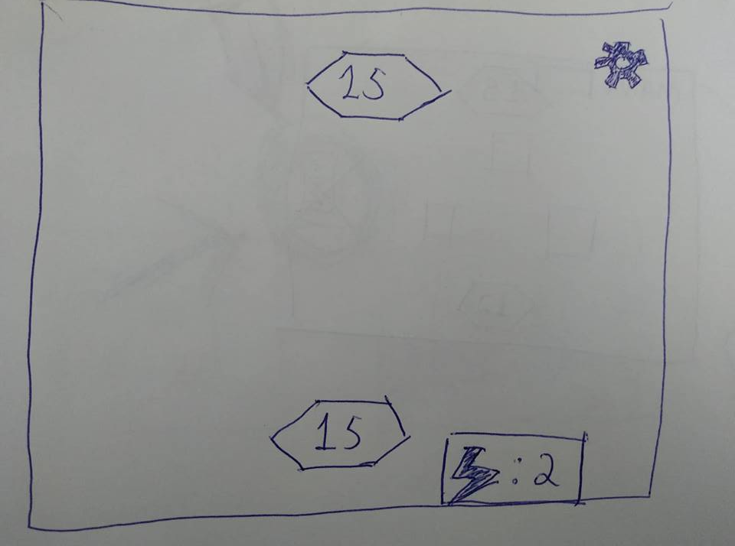
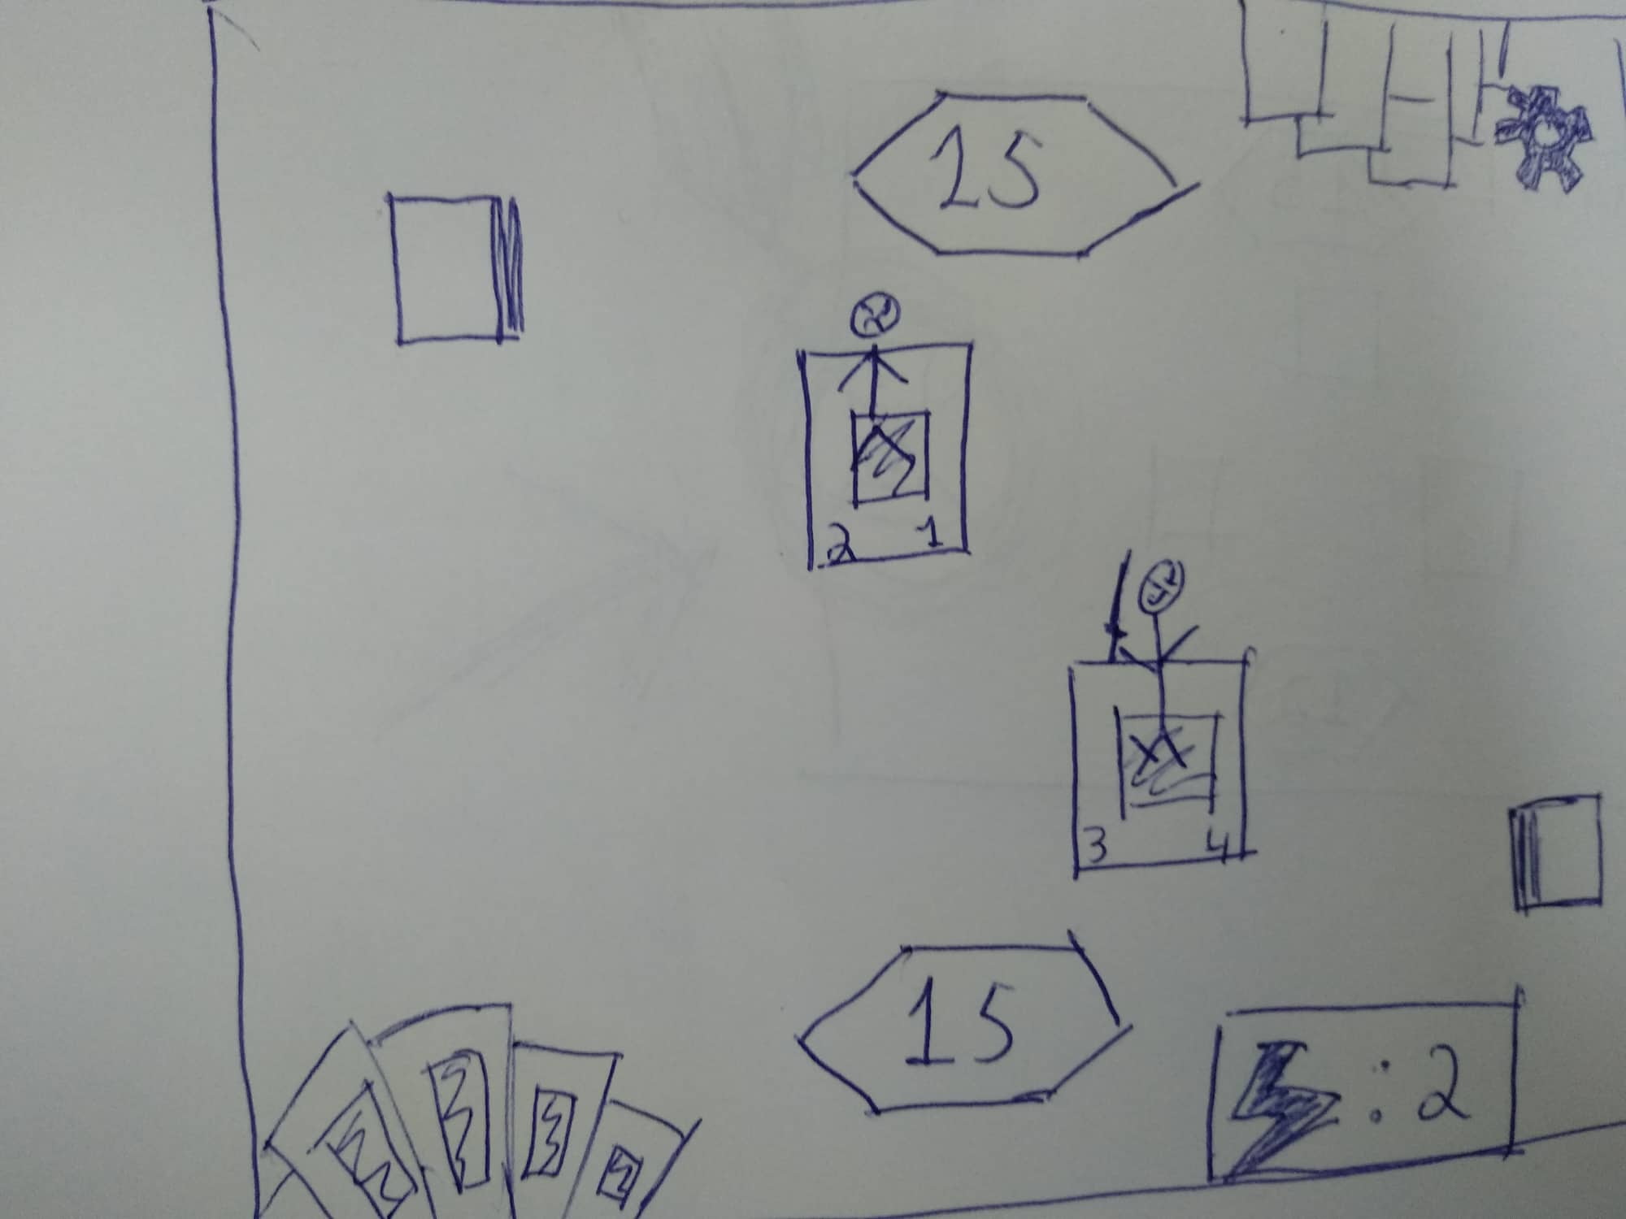
GUI Sketch

Slide 5
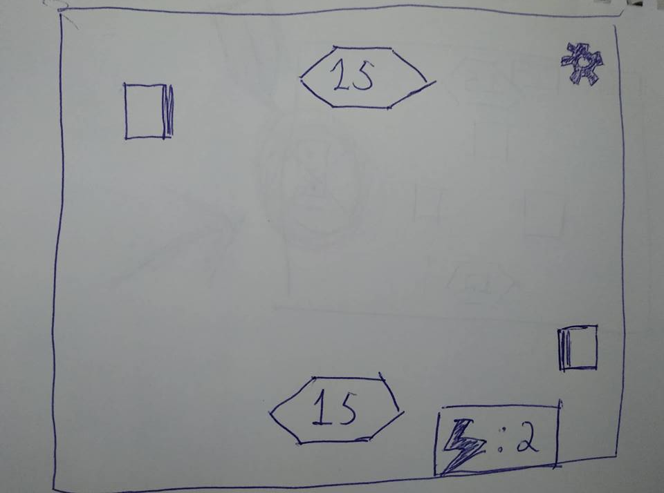
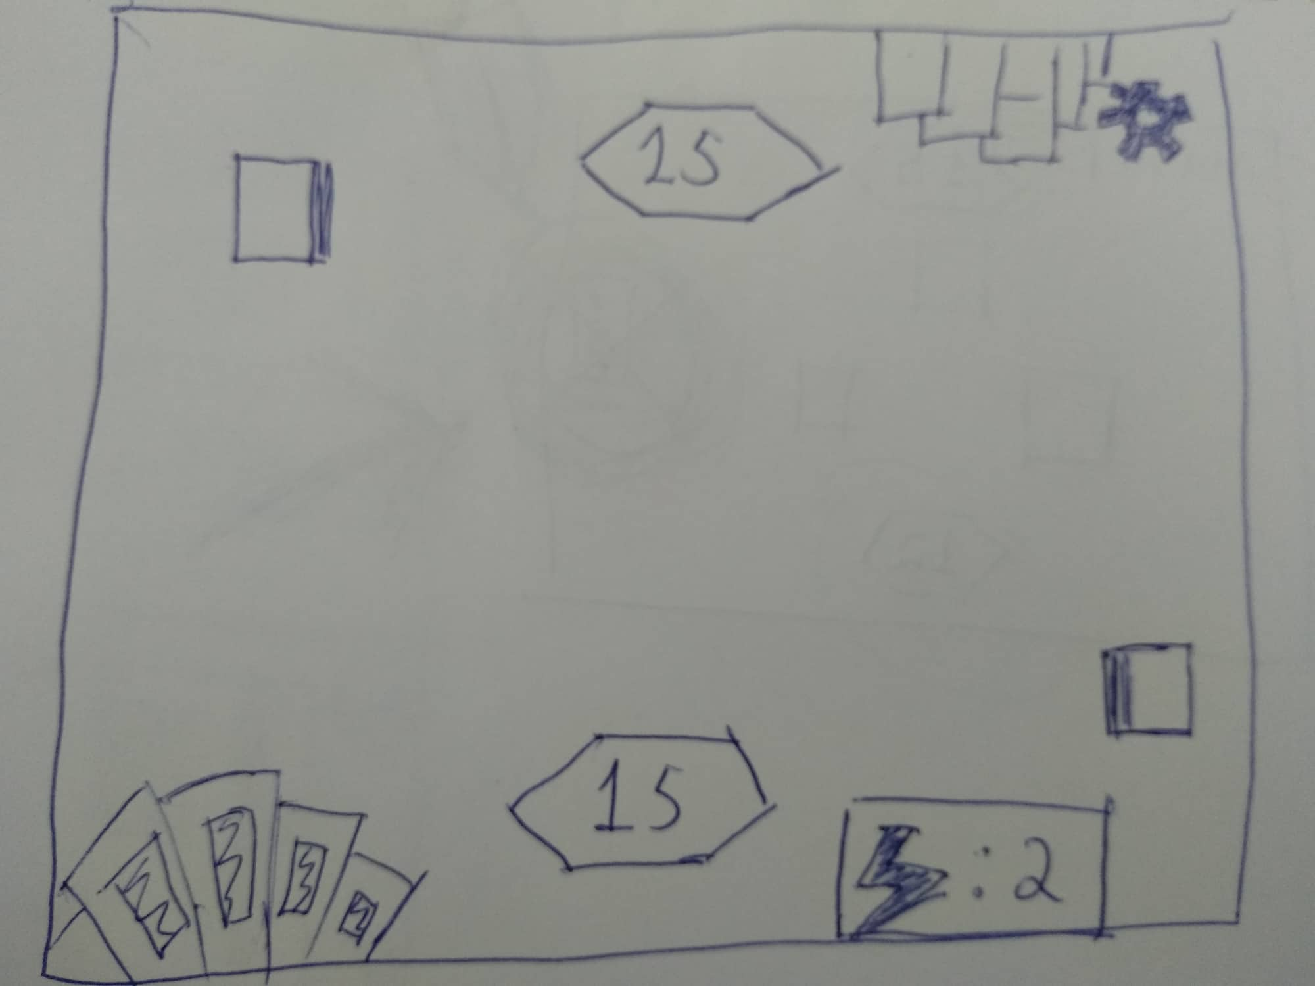
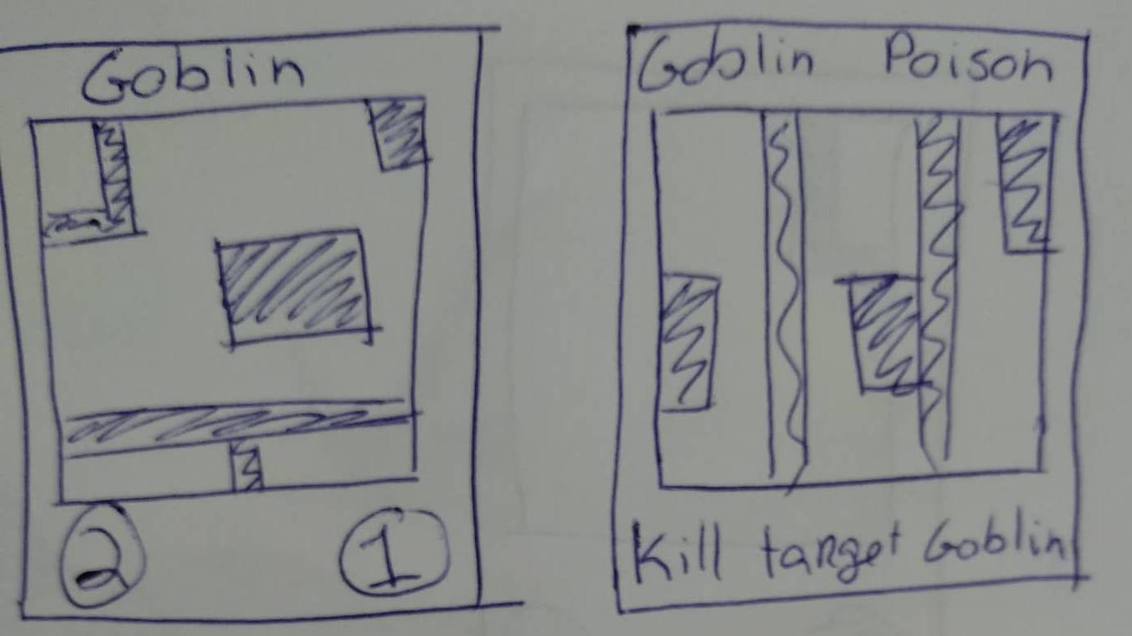
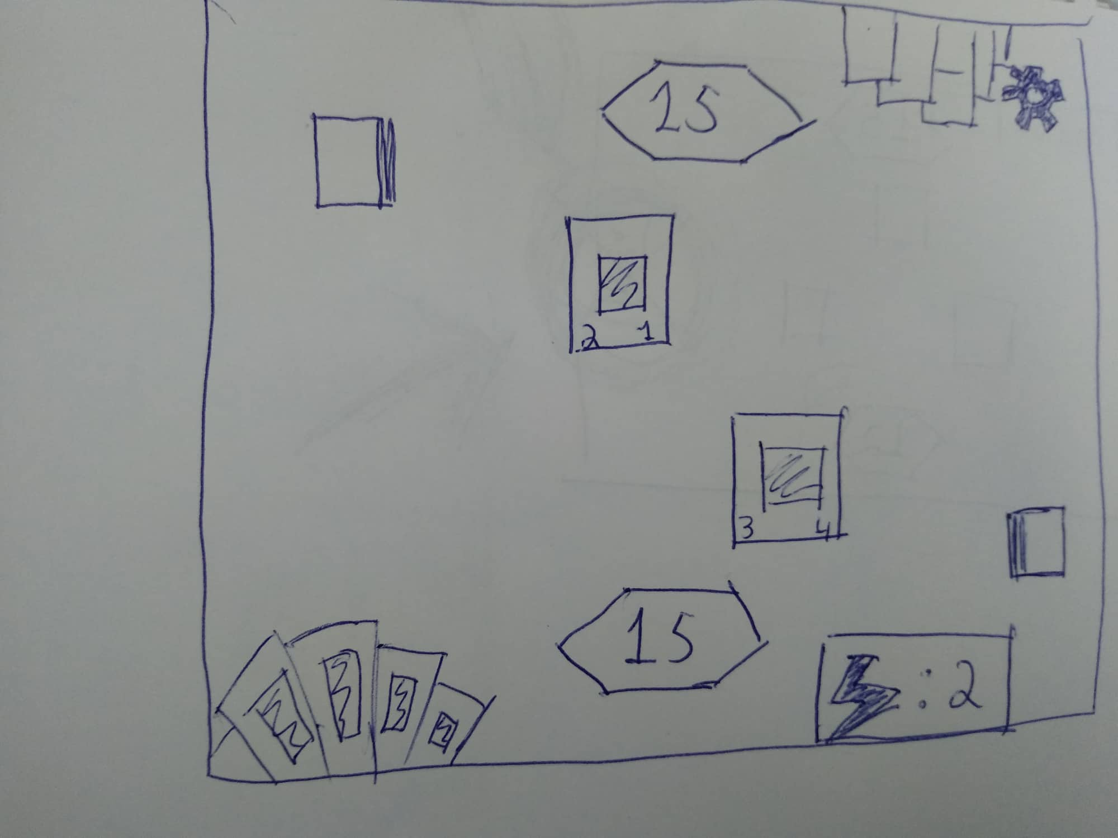
Storyboard

Slide 6
Tasks
Monster cards (life and attack), Spell cards (effect)
Card recognition system: card detection and identification
Give monster cards a 3D Model
Give spells an effect animation
Give each model an idle and attack animations
Combat system: attack detection, resource modification
User interface: self and enemy life, turn, victory/defeat, start/exit/surrender

Slide 7
21/11 checkpoint
Monster cards (life and attack), Spell cards (effect)
Card recognition system: card detection and identification
Give monster cards a 3D Model
Give spells an effect animation
User interface: self and enemy life, turn, victory/defeat, start/exit/surrender

Slide 8
Additional work
Add a mana system
Add play validity
Add hit and death animations
Add sound effects
Add more cards

